Slide 1

Hour of code
December 4th
During your free period
Room 238
Minecraft Adventurer

Slide 2


Slide 3


Slide 4


Slide 5
Design and drawing for production
Unit 6 – Multiview Drawing
Section 1 – Orthographic Projections

Slide 6
The big idea
Process of explaining three-dimensional objects in two-dimensions
Called Orthographic Projections or Multiview Drawings
Typically have three views

Slide 7
Multiview drawing
A major type of drawing used in industry
The views show size and shape of an object
They are arranged in such a way to incorporate projections
Top view is always above the front view
The right-side view normally appears to the right of the front view
Lines are either parallel or perpendicular to one another

Slide 8
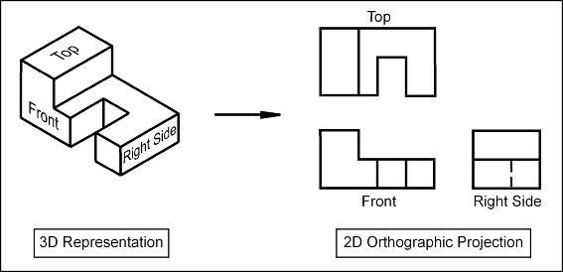

Slide 9
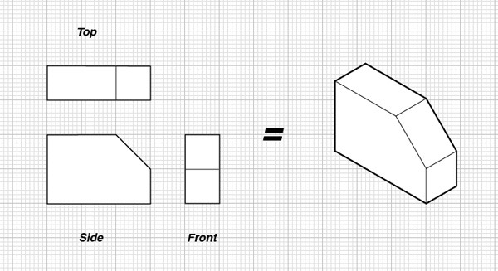

Slide 10
Multiview Drawing #15
Multiview Drawing Unit

Slide 11
